Slide 1


Slide 2

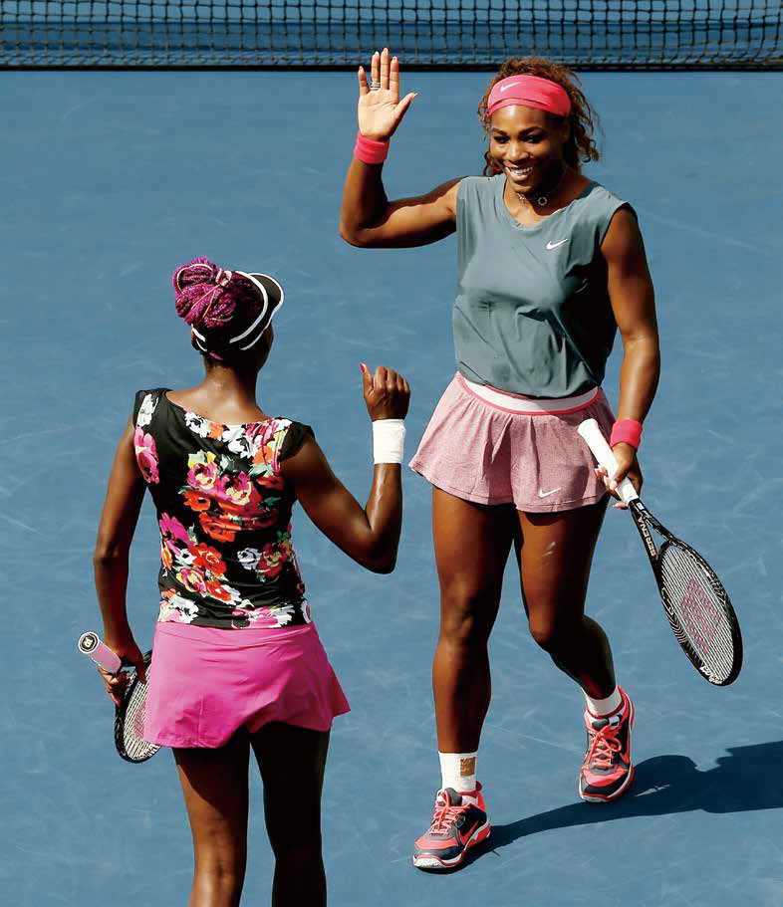






Contents
Active Reading 2

Slide 3



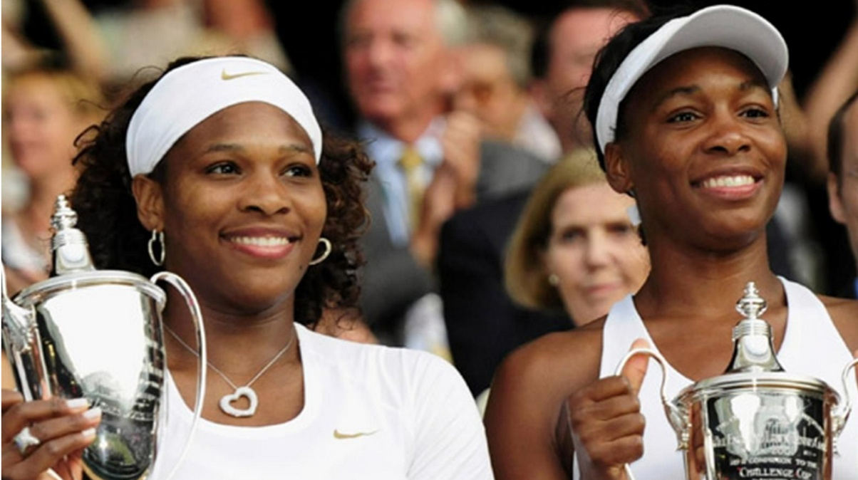

Warming Up
Watch the movie clip and discuss the questions:
What do you know about Venus and Serena Williams, sisters and tennis legends?
Do you know other famous sisters or brothers in sports circle?

Slide 4


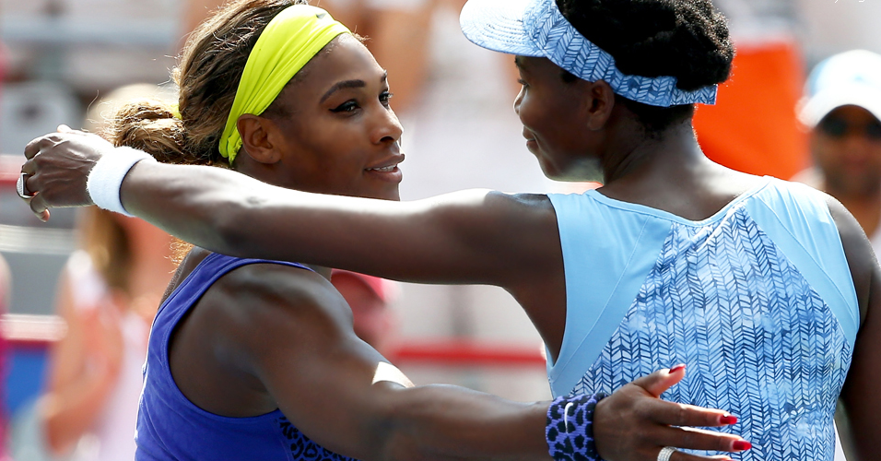
Text
Relative values:
Venus and Serena Williams,
sisters and tennis legends

Slide 5


Text
Relative values:
Venus and Serena Williams,
sisters and tennis legends
Venus and Serena Williams are two of the most famous tennis players in the world. Between them they have won more than 50 singles titles, and over 20 doubles titles. Venus won her first Grand Slam singles title at Wimbledon in 2000, aged 19. Serena won the US Open in 1999, aged 17. They have three older sisters.

Slide 6
Text
1 SERENA: Venus and I have always been determined to do well,
to succeed, to do the best we possibly can. You could say that
we’re perfectionists. It’s definitely something that’s innate. I can’t
remember not ever thinking that way. I can think back to a time – I
couldn’t have been more than five or six – when I had this piece of
homework to do. And I was so determined to get an “A” grade that
I just did it over and over again, until I felt it was perfect. I guess
it was a bit like playing tennis. I wasn’t going to give up until my
paper was the best in the class. So there were plenty of early signs.
I’m sure my sister was the same.

Slide 7
Text
2 Of course our parents played a pivotal role in our success. My mum
would say that if Dad was the body, she was the spine. And that’s
true: She really was that important. I know a lot of people think of
Dad as the one who pushed us, and sure, if I didn’t want to practise
one day, Mum might be the one to say: “That’s okay.” But she’d
soon be telling me I’d have to get myself together and get out there
again. It wasn’t like she was the soft one at all, and that’s what you
really need. You can’t have one parent pulling in one direction and
the other one pulling in the other. They both wanted the same thing
for us, so in a way that was perfect.

Slide 8
Text
3 Venus and I weren’t born with silver spoons in our mouths. We
didn’t have a line of Mercedes outside the house. But we weren’t
what we’d call poor either: We were never hungry, we never went
without – and that’s what I consider true poor. I suppose the main
thing is that, growing up, nothing was handed to us on a plate. And,
like Dad, Mum was out working to keep things going. So when it
came to us, we pretty much had to earn anything that came our way.
And I’m thankful for that because, even though we’re still relatively
young, I can already see how it’s been an important building block in
both our characters.

Slide 9
Text
4 I’d probably say that I’m a little bit more outgoing than Venus, a little
bit more prepared to take risks. I'll probably be the one to try things
out. But on the other hand I’m more private, more likely to store
things up inside, whereas Venus is more outspoken, more likely to
tell it how it is. If we had a squabble – not that we do, really – she’d be
more likely to get things off her chest, for sure. But she doesn’t even
need to open her mouth: I can tell what kind of mood she’s in. And I’m
sure she’d say the same about me. Although she’s only slightly older
than me, Venus has always been the protective older sister. In fact,
she’s not only like that with me, but with her older sisters too! I guess
it's just in her nature to think like that.

Slide 10
Text
5 VENUS: My earliest memory of Serena is pushing her around in her
stroller. Not being that much older, though, that probably meant I’d
just be wheeling her around the house a hundred times. I always
seemed to be taking care of her. And then, really, it wasn’t long before
the tennis came along. I probably started playing when I was five.
We didn’t play each other to begin with, though, because we couldn’t
keep a ball in play. We started off playing in the neighbourhood courts
of Compton, Los Angeles, where we grew up. Most people didn’t play
tennis round there, especially kids. But that didn’t bother us. People
ask whether we had distractions, but to be honest, we didn’t. It’s not
like we had jobs, or things to take care of, or bills to pay. All we had to
do was be a kid and go out there and hit the ball. So that was easy.

Slide 11

Text
6 What with playing tennis together and sharing bedrooms until I was
15, Serena and I have always been close. But I think people tend to
group us together as if we’re the same person sometimes. And we’re
not. We’re like any other pair of siblings – we have differences the
way any siblings do. One of the many things I love about her is that
she's got this great sense of humour.

Slide 12
Text
Recently she’s been making these
funny videos and they’ve had me laughing my head off. I’m laughing
just thinking about them. That’s typical of Serena. Of course, being
the baby in the family we’ve always tried not to spoil her, but she’s
so sweet, even now it’s difficult not to. I suppose, being that bit older
than her, I’ve definitely got that older-sister syndrome where she’s
concerned. I’ve always been very protective of her and I probably
always will be.
■

Slide 13

Text
亲姐妹的价值观：
网坛传奇姐妹花
维纳斯·威廉姆斯和塞雷娜·威廉姆斯
维纳斯·威廉姆斯和塞雷娜·威廉姆斯是两位世界著名的网球选手。她们荣获了50多个单打冠军，20多个双打冠军。2000年，年仅19岁的维纳斯在温布尔登网球赛上赢得了她的第一个单打大满贯。1999年，年仅17岁的塞雷娜在美国网球公开赛上获得冠军。她们还有三个姐姐。

Slide 14
Text
1 塞雷娜：维纳斯和我总是下决心要把事情做好，要获得成功，要尽自己最大的努力。你可能会说我们是完美主义者。这确实是一种天性。我向来都是这么想的。我还记得有一次——大概五六岁的时候——我要完成一项家庭作业。我下定决心要得优秀，于是就一遍又一遍地修改，直到自己觉得满意为止。我想这有点儿像打网球。如果我的作业不是班里最好的，我就不会放弃努力。所以，我小时候就显示出许多我将来会成功的迹象，我确信我姐姐也是这样的。

Slide 15
Text
2 父母对我们的成功起了决定性的作用，这是毫无疑问的。我妈妈常说，如果爸爸是身体，那么她就是脊梁。妈妈说得对，她确实有那么重要。我知道有很多人认为一直是爸爸在逼我们练球，这是事实。如果有一天我不想练球，只有妈妈会说：“没关系。”可过不了多久，她又会说，得收收心，该出去练球了。其实她也不是那么好说话的，而这正是你所需要的。你的父母总不能一个把你往这个方向拽，另一个把你往那个方向拉吧。他们俩对我们的要求是一致的，所以在某种程度上说，他们配合得很好。

Slide 16
Text
3 我和维纳斯并不是生在富贵人家。我们家门口也没有停着一溜儿奔驰车。但是，我们也不是穷人：我们从来没饿过肚子，没缺过什么——我认为那才是真穷呢。我想，最重要的一点是，在我们的成长过程中，每一样东西都是靠自己的努力得来的。像爸爸一样，妈妈也要出去工作，养家糊口。因此，当轮到我们时，我们也一样要把自己该做的事情做好。我对此心存感激，因为虽然我们还年轻，可我已经认识到，这对塑造我们的性格起了很大的作用。

Slide 17
Text
4 我觉得我比维纳斯略微外向些，也更愿意冒险。我可能更愿意去尝试新鲜事物。但另一方面，与维纳斯相比，我更孤僻些，喜欢把事情藏在心里；而维纳斯更坦率，更愿意将自己的想法和盘托出。假如我们为琐事争吵——这其实是没有的事——她肯定会把憋在心里的话说出来。可是她甚至根本不需要开口，因为我能体会到她的心情。我敢说她也能体会到我的心情。虽然她比我大不了多少，她却一直像个大姐姐一样保护着我。其实，她不仅对我这样，对她的姐姐也是这样。我想她的天性就是如此吧。

Slide 18
Text
5 维纳斯：我对塞雷娜最早的记忆是她坐在小推车里，我推着她到处转。虽然我比她大，但因为大不了多少，所以我也就只能推着她围着房子转个一百圈。我好像一直在照顾她。后来不久，我们就开始打网球了。我大概是五岁开始打球的。刚开始的时候，我们并没有互相对打，因为我们还都接不到球。我们是在洛杉矶的康普顿长大的，而且就在康普顿居民区的网球场练球。那儿大多数人都不打网球，孩子们就更不打了。但那并不影响我们。有人问我们，小时候有没有什么让我们分心的事情，可说实话，没有任何让我们分心的事情。我们不必工作、不需要干活儿或者挣钱付账单。我们只要做好小孩子该做的事情和出去打球就行了。事情就是那么简单。

Slide 19
Text
6 在15岁以前，我都是和塞雷娜一起打球，还和她睡在同一间卧室里，所以我们一直亲密无间。可我觉得人们有时候喜欢把我们俩混为一谈，好像我们是一个人，其实不是。我们就像其他兄弟姐妹一样，也有不同之处。塞雷娜极具幽默感，这点最让我喜欢。

Slide 20
Text
最近她拍了几段滑稽录像，看得我简直要笑破肚皮了。现在想起来我还想笑呢。那就是典型的塞雷娜。她是家中最小的孩子，我们一直尽量不把她给宠坏了。可她真是太可爱了，我们到现在都没法不宠她。我想，可能是因为比她年龄大一点，我对她确实有那种当姐姐的情结，我总是想保护她，而且我会永远这么做。

Slide 21

Words & Phrases
legend
outspoken
perfectionist
squabble
definitely
mood
innate
protective
pivotal
stroller
spine
distraction
thankful
sibling
relatively
spoil
outgoing
syndrome
whereas

Slide 22
Words & Phrases
think back
over and over (again)
think of sb. / sth. as sth.
get oneself together
be born with a silver spoon in your mouth
go without
when it comes to (doing) sth.
come sb.’s way
take a risk
(on the one hand ...) on the other hand

Slide 23
Words & Phrases
store sth. up
get sth. off your chest
for sure
come along
to begin with
in play
start off
to be honest
what with
laugh / shout / scream sb.’s head off

Slide 24
Words & Phrases
Venus Williams 维纳斯•威廉姆斯
Serena Williams 塞雷娜•威廉姆斯
Grand Slam 大满贯
Wimbledon 温布尔登网球公开赛
The US Open 美国网球公开赛
Mercedes (Mercedes-Benz) 梅塞德斯–奔驰汽车
Compton 康普顿 （美国加利福尼亚州南部城市）

Slide 25
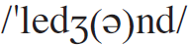

Words & Phrases
legend n. [C]
1. sb. who very many people know about and admire 传奇人物
e.g.
1. He has become a legend in the annals of military history.
他已成为军事史上的一个传奇。
2. Both men were legends in their own time.
这两个人在他们各自的时代都是传奇人物。
2. an old story about famous people and events in the past 传说；传奇故事
e.g. He told us the legend of the ghostly horseman.
他给我们讲幽灵骑士的传说。
Word family: legendary a.

Slide 26
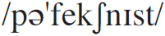
Words & Phrases
perfectionist n. [C] sb. who always wants things to be done perfectly 完美主义者
e.g.
You did fine! Don’t be such a perfectionist.
你做得不错！不要苛求尽善尽美。
Virginia was a perfectionist. She was just not prepared to settle for anything mediocre.
弗吉尼娅是个完美主义者，她根本不愿意拿普普通通毫无特
色的东西将就。
Word family: perfect a. perfection n.

Slide 27
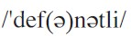
Words & Phrases
definitely ad. without any doubt 毫无疑问地；肯定地
e.g.
1. I shall definitely be at the airport to meet you.
我肯定会到机场去接你。
2. The team will definitely lose if he doesn’t play.
如果他不参加比赛，这个队必输无疑。

Slide 28
Words & Phrases
innate a. an innate quality or ability is one that you have always had 天生的；固有的；内在的
e.g.
Donna had an innate ability to sense when someone was unhappy.
唐娜有一种与生俱来的本领，能觉察出谁心情不好。
Correct ideas are not innate in the mind, but come from social practice.
正确的思想不是与生俱来的， 而是来源于社会实践。

Slide 29
Words & Phrases
pivotal a. extremely important and affecting how sth. develops 至关重要的； 极为关键的
e.g.
He played a pivotal role in the negotiations.
他在谈判中起了极为关键的作用。
He sees these reforms as pivotal to our economic interests in Asia.
他认为这些改革对我们在亚洲的经济利益至关重要。
The Small Business Act had a pivotal role in job creation.
《小型企业法》在创造就业机会方面起了关键性的作用。

Slide 30
Words & Phrases
spine n. [C] the row of bones down the middle of your back 脊椎；脊柱
e.g.
He sustained an injury to his spine when he fell off his horse.
他从马上摔下来， 伤了脊梁骨。
His spine developed a slight curve.
他的脊柱有点弯曲。

Slide 31
Words & Phrases
thankful a. grateful for sth., or pleased that sth. unpleasant is no longer happening or did not happen 感激的；感谢的；庆幸的
e.g.
I’ll be thankful for a good night’s sleep after the week I’ve had.
经历了这样的一周，我能好好睡上一宿就感激不尽了。
You should be thankful that you have me to look after you.
你应该庆幸有我来照料你。
Word family: thank v. thankfully ad.
thankfulness n.

Slide 32
Words & Phrases
relatively ad. in comparison with a similar thing, person, group etc. 相比较地
e.g.
The drug has relatively few known side effects.
相对而言，这种药已知的副作用比较少。
Although Europe’s economy was growing, it was falling behind relatively.
尽管欧洲经济也在增长，但相对而言是落后了。
relatively speaking: used when comparing sth. with all similar things 相对来说
e.g. Relatively speaking, it’s not important.
相对而言，这并不重要。

Slide 33
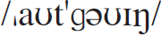
Words & Phrases
outgoing a. sb. who is outgoing is friendly and enjoys meeting and talking to people 外向的；爱交际的
e.g.
1. She’s got a warm outgoing personality.
她具有一种热心、外向的个性。
2. The young guy is outgoing and lively.
那个小伙子性格开朗又活泼。

Slide 34
Words & Phrases
whereas conj. used for comparing two things, people, situations etc. and showing that there is an important difference between them 尽管，但是，却（用于比较两 个事物、人或情景等，显示两者有重要差别）
e.g.
Some of the studies show positive results, whereas others do not.
有些研究结果令人满意，然而其他的则不然。
They want a house, whereas we would rather live in a flat.
他们想要一栋房子， 而我们宁愿住在公寓里。
Pensions are linked to inflation, whereas they should be linked to the cost of living.
养老金与通货膨胀挂钩，然而它们其实应该和生活费用挂钩。

Slide 35
Words & Phrases
outspoken a. an outspoken person states their opinion honestly, even if other people do not like it 直言的；坦率的
e.g.
I am sure he is an outspoken critic of the country’s human rights policies.
我肯定他是一位对该国人权政策直言不讳的评论家。
He became an outspoken opponent of the old educational system.
他直言不讳地抨击旧的教育体制。
Word family: outspokenly ad. outspokenness n.

Slide 36
Words & Phrases
squabble
1. n. [C] a quarrel about sth. unimportant 争吵；口角
e.g. I always have to settle squabbles between the children.
我总是得平息孩子间的争吵。
2. vi. to argue with sb. about sth. that is not important（为琐事）争吵，发生口角
e.g. The kids are still squabbling about whose turn it is to
wash the dishes.
孩子们仍然在为该轮到谁洗碗而争吵。

Slide 37
Words & Phrases
mood n. [C, U] the way sb. is feeling, for example whether they are happy, sad, or angry 心情；心境；情绪
e.g.
His moods change very quickly — one moment he’s cheerful and the next he’s sunk in despair.
他的情绪变化无常——一会儿兴高采烈，一会儿又垂头丧气。
It was Christmas and everyone was in festive mood.
当时是圣诞节，每个人都沉浸在节日的欢乐中。
put sb. in a good / bad mood: to make them feel happy or annoyed 使某人心情愉快 / 不愉快
e.g. I’d been stunk in the traffic for hours, which put me in a
really bad mood.
我被困在车流中好几个小时，心情坏透了。

Slide 38
Words & Phrases
protective a. wanting to protect sb. from being harmed or hurt 爱护的；保护（性）的
e.g.
I can’t help feeling protective towards my kids.
我对自己的孩子自然而然地有种保护欲。
She’s too protective towards her children; she should let them be more independent.
她对孩子太过于爱护， 她应当给他们更多的独立性。
Word family: protectively ad. protectiveness n. [U]

Slide 39
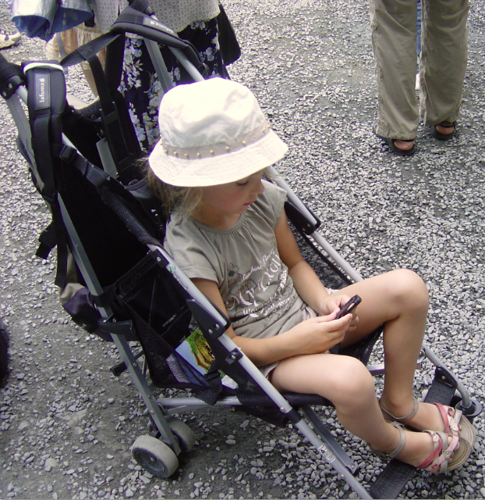
Words & Phrases
stroller n. [C]
1. (AmE) a pushchair for small children 婴儿手推车
e.g. It is difficult for her to climb up the
stairs pushing the stroller with the
baby in it.
推着里面有个婴儿的手推车爬楼对她
来说真困难。
2. sb. who is having a slow walk for pleasure 散步者；闲逛者
e.g. There were many shady gardens
where strollers could relax.
有许多能让散步者放松的荫凉花园。

Slide 40
Words & Phrases
distraction n. [C, U] sth. that gets your attention and prevents you from concentrating on sth. else 分散注意力的事物；使人分心的事物
e.g.
I have to study in the library — there are too many distractions at home.
我得在图书馆学习——家里让人分心的事太多。
The TV is a distraction when I’m working.
我工作的时候， 电视使我分心。
Word family: distract v.

Slide 41
Words & Phrases
sibling n. [C] your siblings are your brothers and sisters 兄弟（或姐妹）
e.g.
The younger children were badly treated by older siblings.
年龄小的孩子被哥哥姐姐欺负。
Many of us hate living in the shadows of a more successful sibling.
我们很多人都讨厌活在更为成功的兄弟姐妹的阴影下。
sibling rivalry: competition between brothers and sisters for their parents’ attention or love 同胞竞争；手足相争(指兄弟姐妹为得到父母的关注或爱的竞争)

Slide 42
Words & Phrases
spoil vt.
1. to always allow a child to have or do everything they want, so that they learn to think only of themselves 宠坏；惯坏；溺爱
e.g.
1. The last thing I want to do is to spoil my children.
我最不愿意做的事就是惯坏我的孩子。
2. He is a spoilt / spoiled child.
他是个被宠坏的孩子。

Slide 43
Words & Phrases
2. to affect sth. in a way that makes it worse, less attractive, or less enjoyable 损坏；糟蹋；毁掉；破坏
e.g.
Our holidays were spoilt by bad weather.
我们的假日被恶劣天气所破坏。
A series of political blunders spoilt their chances of being re-elected.
一系列重大政治失误毁掉了他们重新当选的机会。
Mom arrived home just then, which spoiled everything.
妈妈就在这时回家了，完全打乱了我们的计划。

Slide 44
Words & Phrases
syndrome n. [C]
1. a set of feelings or actions that are typical in a particular situation （在某种情况下的）一系列情绪（或举动）
e.g.
It’s a bit like the exam syndrome where you write down everything you know regardless of what has been asked.
不论问题是什么就把所知道的统统写上，这有些像典型的考
试心理。
Scientists call this the “it won’t affect me” syndrome.
科学家把这种现象称为“关我何事”的典型表现。

Slide 45
Words & Phrases
2. a medical condition that has a particular set of effects on your body or mind 综合症状；综合征
e.g.
The syndrome is more likely to strike those whose immune systems are already below par.
这种综合征更容易对那些免疫系统已经低于正常水平的人构
成威胁。
This syndrome mostly affects women in their forties.
这种综合征多出现在四十多岁的女性身上。

Slide 46
Words & Phrases
think back: to think about sth. that happened in the past 回想；回忆
e.g.
When I thought back to those nights, it was the crunch of snow and the warm lights from the windows that I remembered.
当我回想起那些夜晚时，我记得的是踩在雪地上的咯吱声和
从窗户里映照出来的温暖灯光。
I keep thinking back to school.
我老回忆起在学校的日子。

Slide 47
Words & Phrases
over and over (again): many times 一再地；再三地
e.g.
The only way to learn the script is to say it to yourself over and over again.
要背熟剧本的唯一办法是自己反复地念。
They keep asking the same questions over and over again.
他们一遍又一遍地问那些同样的问题。

Slide 48
Words & Phrases
think of sb. / sth. as sth.: to have a particular opinion about sb. or sth. 有…看法
e.g.
1. Dick thinks of himself as a genius in literature.
迪克自以为是个文学天才。
2. We think of him as representing modern writers.
我们认为他是现代作家的代表。
3. I get sick of being thought of as a political automaton.
我讨厌被看作政治机器。

Slide 49
Words & Phrases
get oneself together: to begin to be in control of one’s life, one’s emotions etc. 平静下来；镇定下来
e.g.
I had to take a break for a cup of tea before I could really get myself together.
我得休息片刻喝杯茶来平复心情。
He could no longer get himself together and rushed out of the room.
他再也不能控制自己，冲出了房间。

Slide 50
Words & Phrases
be born with a silver spoon in your mouth: to belong to an upper-class family and have a lot of social advantages because of that 生在富贵人家
e.g.
The stranger’s conduct was that of a man who had been born with a silver spoon in his mouth.
这陌生人的举止像是来自富贵人家。
She was born with a silver spoon in her mouth and has never done a day’s hard work in her life.
她出生于富贵人家，这辈子从未做过一天的苦活。

Slide 51
Words & Phrases
go without: to live without sth. that you need or would like to have 没有（生活所需物等）
e.g.
1. In those days we often had to go without supper.
那时候我们常常没饭吃。
2. Since there is no butter left, we had to go without.
既然黄油用光了，我们只得将就一下。
3. We can’t afford a holiday, so we’ll just have to go without.
我们没钱度假，所以只好不去。

Slide 52
Words & Phrases
when it comes to (doing) sth.: when the subject being discussed is a particular thing 谈到（做）某事时
e.g.
They don’t accept any foolishness when it comes to spending money.
在花钱的问题上，他们向来很谨慎。
Toddlers are notoriously antisocial when it comes to sharing toys.
众所周知，刚学会走路的孩子不愿和别人分享玩具。
The French are proud and highly xenophobic when it comes to cooking.
谈到烹饪，法国人会颇为得意并且非常排斥外国菜。

Slide 53
Words & Phrases
come sb.’s way: if sth. comes your way, it happens to you, or it becomes available （某事物）发生在某人身上，被某人碰到， 可为某人所用
e.g.
Several chances came our way but we missed them.
我们有过好几次机会，不过都没抓住。
You must make the most of the opportunities that come your way.
你必须充分利用碰到的机会。

Slide 54
Words & Phrases
take a risk / take risks: to do sth. although you know that sth. unpleasant or dangerous could happen 冒险
e.g.
The fuel tank could blow up, but that’s a risk we’ll have to take.
燃料罐有可能爆炸，但我们必须冒这个险。
You have no right to take risks with other people’s money.
你没有权利拿别人的钱财去冒险。

Slide 55
Words & Phrases
(on the one hand ...) on the other hand: used for giving two different opinions about sth. （一方面…，）另一方面…
e.g.
On the one hand I want to sell the house, but on the other hand I can’t bear the thought of moving.
一方面我想把房子卖掉，但另一方面我又不愿搬家。
On one hand, some people argued that it is a good thing for middle students to visit the famous university campus. On the other hand, some people hold a negative view about this phenomenon. (CET4-2005-12)
一方面，有些人觉得中学生参观知名大学的校园是一件好事
。但另一方面，有人对此现象持有反对的观点。

Slide 56
Words & Phrases
store sth. up
1. to do sth. that will cause problems in the future 积累，制造（问题）
e.g. Sarah is storing up problems for herself by lying to him.
莎拉对他说谎是在为她自己制造麻烦。
2. to keep a lot of sth. so that you can use it later 储备（大量物品）
e.g.
1. Squirrels are storing up nuts for the winter.
松鼠正在为冬天储存坚果。
2. In expectation of war, many people like to store up food.
预期战争将至，许多人喜欢囤积食品。

Slide 57
Words & Phrases
get sth. off your chest: to talk to sb. about sth. that has been worrying you, so that you feel better about it 倾吐某事
e.g.
People are able to get things off their chest in these meetings.
在这些聚会上，人们可以倾吐他们心中的烦恼。
He came to see me because he wanted to get something off his chest.
他来看我是因为他想倾吐一些事。

Slide 58
Words & Phrases
for sure: definitely 确定无疑地
e.g.
1. I will call you tomorrow for sure.
我明天肯定会打电话给你。
2. “Are you going on Friday?” “I don’t know for sure.”
“你星期五去吗？”“我不能肯定。”
3. No one knows for sure what really happened.
没有人确切地知道到底发生了什么事。

Slide 59
Words & Phrases
come along: to arrive or become available 到达；出现
e.g.
I waited a long time until a script came along that I thought was genuinely funny.
我等了很长时间，直到出现了一个我认为真正逗趣的剧本。
It was lucky you came along.
真幸运你来了。
These troubles came along all at the same time that I was at a loss.
这些麻烦突然一起发生，使我不知所措。

Slide 60
Words & Phrases
to begin with
1. before or during the first part of an activity or process 原来；开始的时候
e.g.
1. It was great to begin with but now it’s difficult.
开始还不错，但现在变得艰难了。
2. It was fine to begin with and then it started to rain.
起初天气很好，后来开始下雨。
2. used for introducing the first thing in a list of things you are going to say 首先；第一
e.g. To begin with, I’d like to tell in brief the importance of
the work.
首先，我想简要谈谈这项工作的重要性。

Slide 61

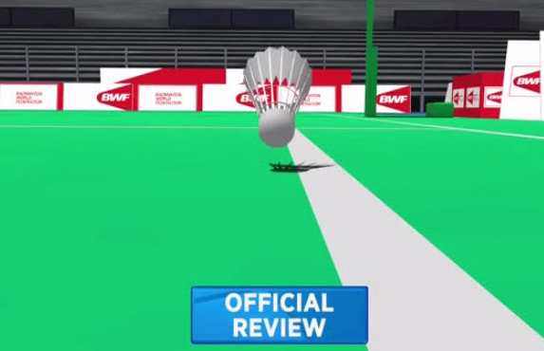
Words & Phrases
in play: if a ball is in play, it is within the area where a game can be played （球）在界内
e.g. He kicked the ball in play.
他把球踢在了界内。
Antonym: out of play 界外

Slide 62
Words & Phrases
start off: to begin or cause sth. to begin （使）开始
e.g.
She started off well, but slowed down halfway through the race.
她开局不错，但比赛半程之后慢了下来。
Let’s start off with a few questions from the audience.
我们以观众提问的方式开始吧。
Richard started the discussion off by telling us about his experiences in Africa.
理查德给我们讲述他在非洲的经历以此开始了讨论。

Slide 63
Words & Phrases
to be honest: (spoken) used when telling sb. what you really think, especially when it may be sth. they do not want to hear 老实说；说实话
e.g.
To be honest the house is not quite our style.
说实话，这所房子不太适合我们。
To be honest, she was more of a hindrance than a help.
说实在的，她没帮上忙，反而成了累赘。
To be honest, I was surprised he knew where I was, we moved so often.
说实话，我觉得不可思议。我们如此频繁地搬家，他竟也知
道我在哪儿。

Slide 64
Words & Phrases
what with: (spoken) used when you are giving a number of reasons for a particular situation or problem 由于，因为 （用于列举某种状况或问题的各种原因）
e.g.
What with the drought and the neglect, the garden is in a sad condition.
由于干旱，加上疏于管理，花园的情况十分糟糕。
What with neighbours, relatives, and friends there, the house was overflowing with people.
由于有邻居、亲戚和朋友在那里，房子里人满为患。

Slide 65
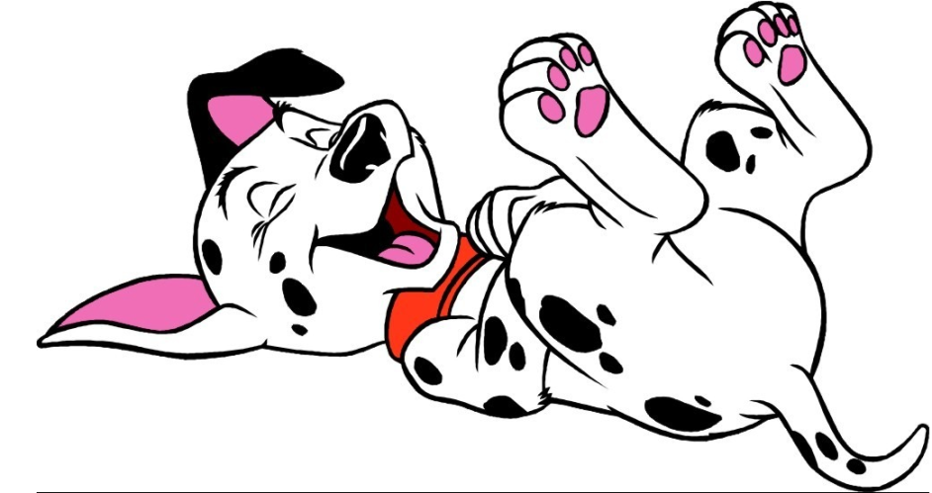
Words & Phrases
laugh / shout / scream sb.’s head off: (infml) to laugh, shout, scream very loudly 大笑 / 大叫 / 大声尖叫
e.g.
1. The children laughed their heads off at the jokes.
这些笑话让孩子们大笑起来。
2. The fans screamed their head off when they saw the star.
见到那个明星，粉丝们大声尖叫起来。

Slide 66
Words & Phrases
Venus Williams 维纳斯·威廉姆斯 （美国职业网球女运动员）
Venus Williams (born June 17, 1980) is an American professional tennis player, who is a former World No. 1 and is ranked World No. 12 in singles as of March 7, 2016. She became the World No. 1 for the first time on February 25, 2002, becoming the first black American woman to achieve this feat during the Open Era. She is credited as changing the women’s game and ushering a new, modern era of power and athleticism on the women’s professional tennis tour. She is also regarded as the best grass court player of her generation and is widely considered as one of the all-time greats of women’s tennis. Her seven Grand Slam singles titles are more than those of any other active female player except for her younger sister Serena Williams.

Slide 67
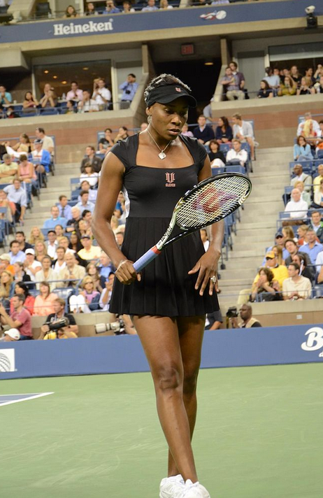
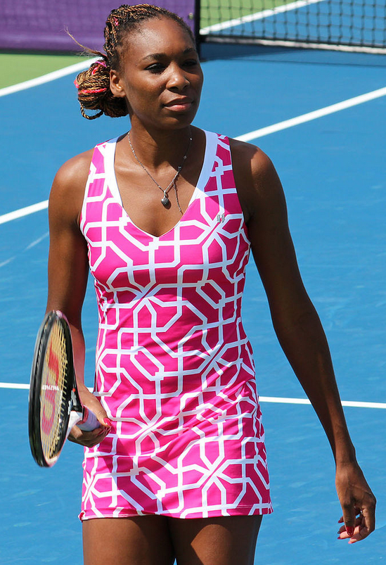
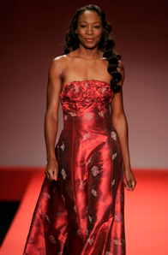
Words & Phrases

Slide 68
Words & Phrases
Serena Williams 塞雷娜·威廉姆斯（美国职业网球女运动员）
Serena Williams (born September 26, 1981) is an American professional tennis player who is ranked No. 1 in women’s singles tennis. The Women’s Tennis Association (WTA) has ranked her world No. 1 in singles on six separate occasions. She became the world No. 1 for the first time on July 8, 2002. She is the reigning champion of the French Open, Wimbledon and Olympic women’s singles and doubles. Williams is regarded by some commentators and sports writers as the greatest female tennis player of all-time. Williams holds the most major singles, doubles, and mixed doubles titles combined amongst active players, male or female.

Slide 69
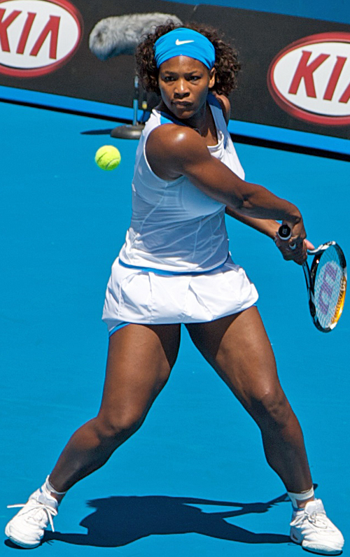
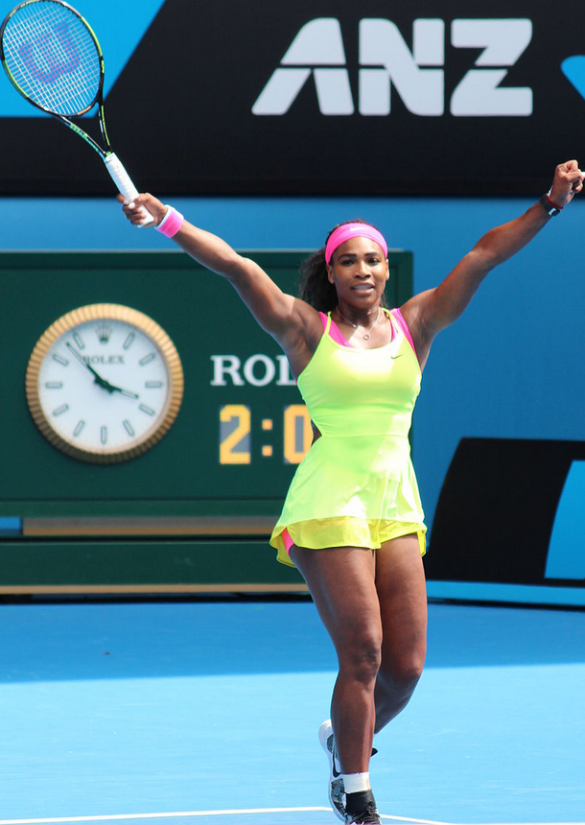
Words & Phrases

Slide 70
Words & Phrases
Grand Slam （全年各项重要比赛的）大满贯
The four competitions in the Grand Slam are the most important events in the tennis year. They are “open”, meaning that any qualified person from any country can take part. The US Open is held at Flushing, New York City, in August-September on hard courts. The French Open is at the Stade Roland Garros, Paris, in May-June on clay courts. The Australian Open is held at Melbourne Park, Melbourne, in January on hard courts. Wimbledon is a British open competition held at Wimbledon, London, in June-July. To win any of these is very difficult. It is very prestigious to be the champion, and top players can earn large amounts of prize money.

Slide 71

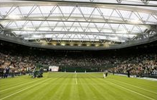

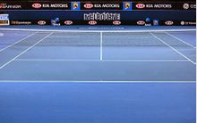

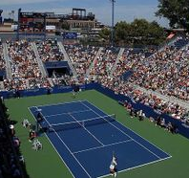

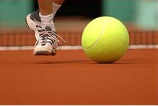
Words & Phrases

Slide 72
Words & Phrases
Wimbledon 温布尔登网球公开赛（每年6月或7月在英国伦敦郊区的温布尔登举行）
The Championships, Wimbledon, commonly known simply as Wimbledon, is the oldest tennis tournament in the world, and is widely considered the most prestigious. The tournament takes place over two weeks in late June and early July, culminating with the Ladies’ and Gentlemen’s Singles Final, scheduled always for the second Saturday and Sunday respectively. Five major, junior, and invitational events are held each year. Wimbledon traditions include a strict dress code for competitors, the eating of strawberries and cream by the spectators, and Royal patronage.

Slide 73
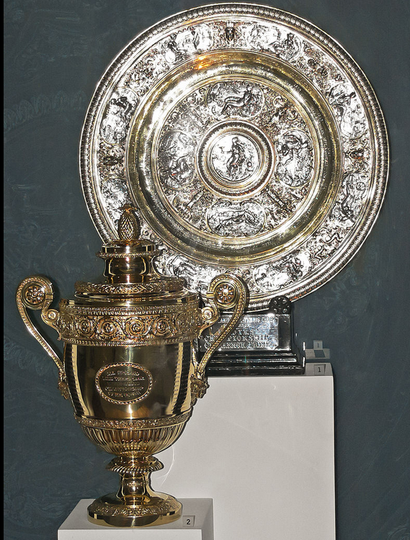
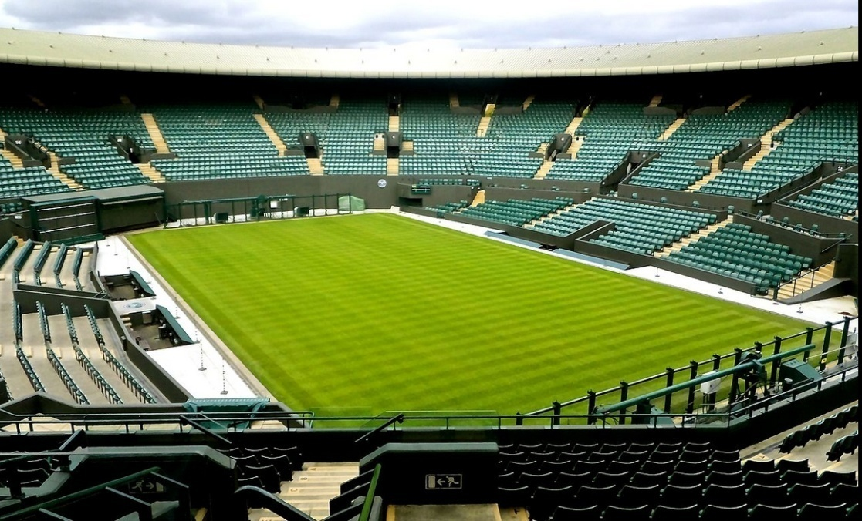
Words & Phrases
Wimbledon Court No. 1
The Ladies’ (top) and Gentlemen’s singles trophies

Slide 74

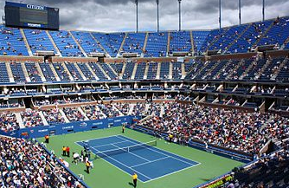
Words & Phrases
The US Open 美国网球公开赛（通常每年8月底至9月初在美国纽约举行）
The United States Open Tennis Championships is a hardcourt tennis tournament which is the modern version of one of the oldest tennis championships in the world, the U.S. National Championship, for which men’s singles was first contested in 1881. Since 1987, the US Open has been chronologically the fourth and final tennis major comprising the Grand Slam each year; the other three are the Australian Open, French Open and Wimbledon.

Slide 75
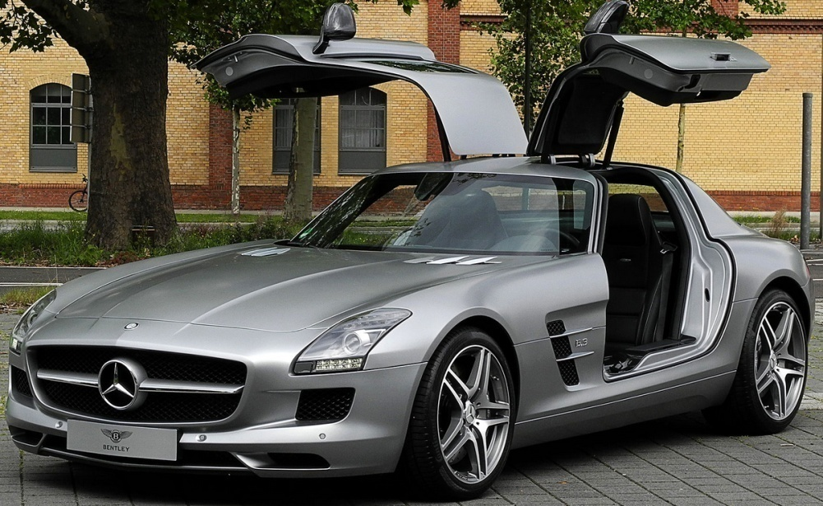

Words & Phrases
Mercedes （Mercedes-Benz）梅塞德斯–奔驰汽车
Mercedes-Benz is a German automobile manufacturer, a multinational division of the German manufacturer Daimler AG. The brand is known for luxury vehicles, buses, coaches, and trucks. The headquarters of Mercedes-Benz is in Stuttgart, Baden-Württemberg, Germany.

Slide 76
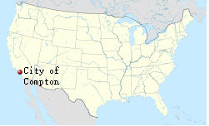
Words & Phrases
Compton 康普顿（美国加利福尼亚州南部城市）
Compton is a city in southern Los Angeles County, California, United States, situated south of downtown Los Angeles. Compton is one of the oldest cities in the county.

Slide 77


Language Points
My mum would say that if Dad was the body, she was the spine.
This comparison makes the mother’s role as important as the father’s, or more important, because the spine is the main support for the body.
翻译：
我妈妈常说，如果爸爸是身体，那么她就是脊梁。

Slide 78
Language Points
But she’d soon be telling me I’d have to get myself together and get out there again.
At times when Serena did not feel like practice, her mother would be accepting at first, but would soon remind her to pick herself up and go practice again.
翻译：
可过不了多久，她又会说，得收收心，该出去（练球）了。

Slide 79
Language Points
It wasn’t like she was the soft one at all …
In most families the mother is seen as soft (kind, sympathetic, gentle) and the father as hard (strict, firm, concerned with discipline). But in Serena’s family, both the parents have similar opinions about how to raise the children.
翻译：
其实她也不是那么好说话的……

Slide 80
Language Points
We were never hungry, we never went without — and that’s what I consider true poor.
Though she and Venus were not born into a wealthy family, they lived a relatively good life, and were never lacking for food or other necessities. So they were not truely poor.
翻译：
我们从来没饿过肚子，没缺过什么——我认为那才是真穷呢。

Slide 81
Language Points
… nothing was handed to us on a plate.
Serena and her sister Venus had to work hard themselves to get what they wanted.
hand sth to sb. on a plate: (infml) to make it easy for sb. to achieve sth. that they would normally have to work hard to get 让某人轻易取得（原本难以获得的事物）；将某物奉送给某人
e.g. The match was handed to them on a plate.
他们轻松地赢得了这场比赛。
翻译：
……每一样东西都是靠自己的努力得来的。

Slide 82
Language Points
… whereas Venus is more outspoken, more likely to tell
it how it is.
tell it how it is: a colloquial idiom which means to give a realistic account of a situation and tell the facts exactly, even if they are unpleasant
翻译：
……而维纳斯为人更坦率，更愿意将自己的想法和盘托出。

Slide 83
Language Points
And then, really, it wasn’t long before the tennis came along.
Soon we began taking up and practising tennis.
It isn’t long before … 句型意为“过了不久就……”
e.g.
It wasn’t long before he found a job and settled down in the new place.
过了不久，他就在新地方找到了工作并定居下来。
It won’t be long before you get used to a new life on campus.
用不了多久你就会习惯校园的新生活的。

Slide 84
Language Points
And then, really, it wasn’t long before the tennis came along.
Also with some other tenses:
e.g.
It will be ten or more years before the new medicine can be used on human beings.
这种新药应用到人类身上，还需要十年或更长的时间。
He was very excited, and it was long before he calmed down.
他很激动，心情久久不能平静。
翻译：
后来不久，我们就开始打网球了。

Slide 85
Language Points
We didn’t play each other to begin with, though, because we couldn’t keep a ball in play.
At the beginning we couldn’t play tennis well. We couldn’t keep the ball within the lines of the playing area.
翻译：
刚开始的时候，我们并没有互相对打，因为我们还都接不到球。

Slide 86
Language Points
What with playing tennis together and sharing bedrooms until I was 15, Serena and I have always been close.
Serena and Venus have always been close because they played tennis with each other and shared bedrooms until Venus was 15.
翻译：
在15岁以前，我都是和塞雷娜一起打球，还和她睡在同一间卧室里，所以我们一直亲密无间。

Slide 87
Language Points
Of course, being the baby in the family we’ve always tried not to spoil her …
Because she is the baby in the family, we’ve always tried not to spoil her.
This sentence contains a dangling participle (“being the baby in the family”). Although this is common in colloquial English, learners should try to avoid them. Dangling participles can be unintentionally funny or even genuinely confusing, and they are, after all, ungrammatical.
翻译：
她是家中最小的孩子，我们一直尽量不把她给宠坏了……

Slide 88
Language Points
… I’ve definitely got that older-sister syndrome where she’s concerned.
In the passage, this is a mildly humorous metaphor in a joking style: Venus has older-sister syndrome because she protects and looks after her younger sister Serena.
翻译：
……我对她确实有那种当姐姐的情结。

Slide 89

Exercises
Reading and understanding
Dealing with unfamiliar words
Reading and interpreting
Developing critical thinking

Slide 90
Exercises
Reading and understanding
3 Choose the best way to complete the sentences.
1 Serena is _________.
(a) the same age as Venus
(b) a little older than Venus
(c) younger than Venus
(d) a lot older than Venus
2 Whatever she does, Serena wants to _______.
(a) do her best
(b) do better than Venus
(c) please her parents
(d) earn money

Slide 91
Exercises
3 Serena was encouraged to do well by ________.
(a) her father
(b) her mother
(c) the whole family
(d) both her parents
4 When they were growing up, the Williams sisters ______.
(a) didn’t have any money
(b) had to work hard for their success
(c) earned a lot of money from their jobs
(d) didn’t need to worry about money

Slide 92
Exercises
5 Venus is different from Serena because Venus______.
(a) is quieter
(b) has a stronger sense of humour
(c) is more private
(d) says what she thinks
6 The two sisters .
(a) don’t get on with each other
(b) are exactly like each other
(c) get on with each other almost all the time
(d) look after each other

Slide 93
Exercises
Dealing with unfamiliar words
4 Replace the underlined words with the correct form of the words below.
5 Complete the sentences with the correct form of the words in Activity 4.
6 Answer the questions about the words and expressions.

Slide 94
Exercises
4 Replace the underlined words with the correct form of the words below.
distraction innate legend mood
outgoing perfectionist protective spoil
1 She is a person who wants to do things perfectly.
perfectionist
2 Venus and Serena’s talent is something they were born with, but they have also worked very hard to be successful.
innate

Slide 95
Exercises
distraction innate legend mood
outgoing perfectionist protective spoil
3 As a student, he found sport and clubs prevented him from concentrating on his main interest, which was science.
distracted
4 My brother is older than me, and when we were at school, he was very determined to look after me so I wouldn’t be harmed.
protective
5 She is really friendly and likes meeting people, but I prefer to do things on my own.
outgoing

Slide 96
Exercises
distraction innate legend mood
outgoing perfectionist protective spoil
6 Grandparents may sometimes allow their grandchildren everything they want and make them selfish if they’re not careful.
spoil
7 The weather can affect your feeling of being happy or unhappy.
mood
8 She was a famous Hollywood person who everyone admired.
legend (She was a Hollywood legend.)

Slide 97
Exercises
5 Complete the sentences with the correct form of the words in Activity 4.
distraction innate legend mood
outgoing perfectionist protective spoil
1 In their schoolwork and their tennis, the Williams sisters have tried to achieve __________.
2 You need to be ________ talented to play tennis at the most competitive level.
3 Venus isn’t as __________ as Serena.
4 As the older sister, Venus likes to _______ Serena from getting hurt.
perfection
innately
outgoing
protect

Slide 98
Exercises
distraction innate legend mood
outgoing perfectionist protective spoil
5 As the youngest child in the family, Serena could have been ________ and allowed to have or do everything she wanted.
6 Serena understands what kind of _______ her sister is in even before she says anything.
7 Playing tennis was all they ever did; they had no other __________ .
8 Li Na is a(n) __________________ tennis player in this century.
spoiled
mood
distractions
legend / legendary

Slide 99
Exercises
6 Answer the questions about the words and expressions.
1 If you get yourself together, do you (a) find something you need, or (b) make yourself calm and organized before doing something?
2 Is go without likely to mean (a) you don’t have things you need, or (b) you have everything you need?
3 If something comes your way, (a) are you given it by someone because you need it, or (b) do you get it by chance?
4 If you store things up, are you likely to (a) ignore them, or (b) remember something which will trouble you later?
5 Is what with used to (a) give a number of reasons for a situation, or (b) describe more than one situation?
6 Answer the questions about the words and expressions.
1 If you get yourself together, do you (a) find something you need, or (b) make yourself calm and organized before doing something?
2 Is go without likely to mean (a) you don’t have things you need, or (b) you have everything you need?
3 If something comes your way, (a) are you given it by someone because you need it, or (b) do you get it by chance?
4 If you store things up, are you likely to (a) ignore them, or (b) remember something which will trouble you later?
5 Is what with used to (a) give a number of reasons for a situation, or (b) describe more than one situation?

Slide 100
Exercises
Reading and interpreting
7 Look at the sentences from the passage and answer the questions about the figurative language.
1 ... Venus and I weren’t born with silver spoons in our mouths.
Is to be born with a silver spoon in your mouth likely to mean born into a rich or a poor family?
It means to be born into a rich or privileged family (they have enough money to have silver spoons for the newborn baby).

Slide 101
Exercises
2 ... nothing was handed to us on a plate.
If something is handed to you on a plate, is it easy or difficult to obtain?
It is easy to obtain and you don’t have to make an effort for it.

Slide 102
Exercises
3 ... I can already see how it’s been an important building block in both our characters.
Is a building block likely to be one of the basic parts that something is made from or a piece of wood that young children play with?
It refers to one of the basic parts that something is made from, which is very important for later development.

Slide 103
Exercises
4 … I’m more private, more likely to store things up inside ...
If you store things up, are you likely to forget about them, or remember them in a way that will cause problems in the future?
You are likely to remember them in a way that will cause problems in the future (a similar expression is bottle it up, like keeping something in a sealed bottle)

Slide 104
Exercises
5 ... She’d be more likely to get things off her chest ...
If you get something off your chest, are you likely to talk about something which has been worrying you so you feel better about it, or to keep it to yourself?
You are likely to talk about something which has been worrying you, so you feel better about it later.

Slide 105
Exercises
6 ... they’ve had me laughing my head off.
If you laugh your head off at something, is it likely to be very funny or very painful?
It is likely to be very funny (similar expressions are I killed myself with laughter / I fell about laughing).

Slide 106
Exercises
Developing critical thinking
8 Work in pairs and discuss the questions.
1 What’s your opinion about the relationship between Venus and Serena?
2 Did the sisters have a “normal” childhood? Do you think their childhood was affected in any way by their talent for tennis?
3 Is it right for parents to encourage their child to train hard for something even if it means the child misses out on a normal childhood?

Slide 107
Exercises
1 What’s your opinion about the relationship between
Venus and Serena?
Their relationship is clearly close. They shared a bedroom until Venus was 15 and they have been good friends. They obviously play tennis very well together and they’ve won many doubles titles.

Slide 108
Exercises
2 Did the sisters have a “normal” childhood? Do you think their childhood was affected in any way by their talent for tennis?
The Williams sisters started tennis when they were very young, which was unusual at that time in Los Angeles. Their father is said to have pushed them and they didn’t have any distractions — all they had to do was play tennis. This didn’t sound like a “normal” childhood and it was obviously affected by their great talent for tennis.

Slide 109
Exercises
3 Is it right for parents to encourage their child to train hard for something even if it means the child misses out on a normal childhood?
Generally yes, if the child is keen to do it and has talent. Of course, the talent is only seen when the child has an opportunity and makes an effort. Even so, children need a balance with their social life.

Slide 110

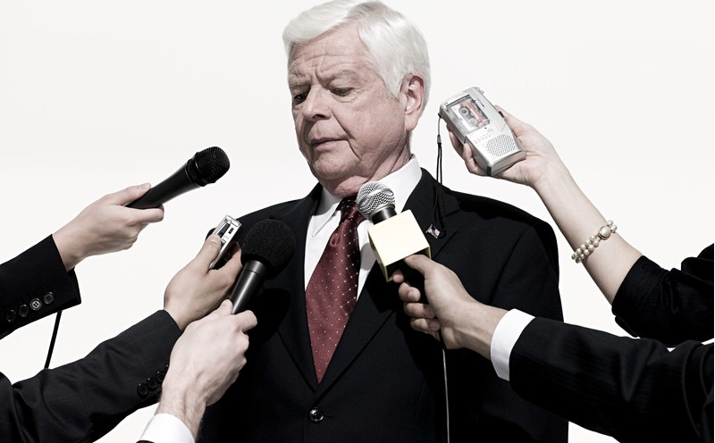
Extension Activities
What is an interview?
An interview is an occasion when a famous person is asked questions about their life, experience, or ideas for a newspaper, magazine, TV program etc.

Slide 111
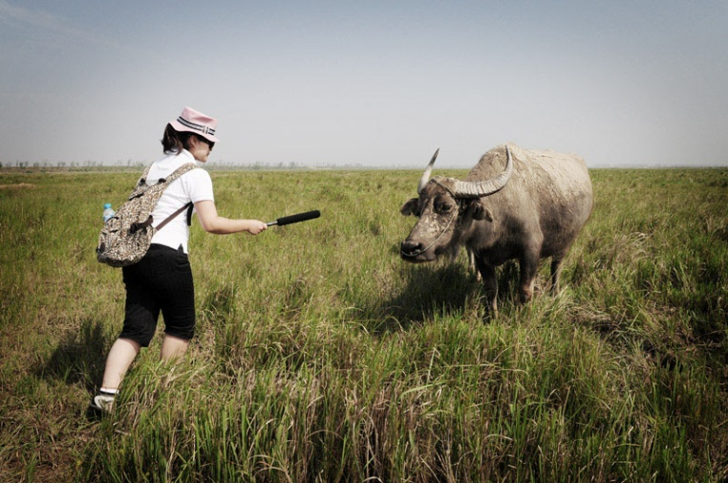
Extension Activities
Types of Interviews
Interview methods
Interview format
Interview preparation
Helpful interview hints

Slide 112
Extension Activities
Types of interviews
There are three types of interviews:
Opinion interviews
Information interviews
Personality interviews

Slide 113
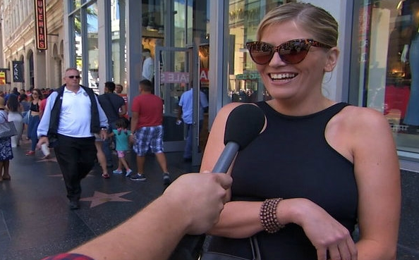
Extension Activities
Opinion interviews
The opinion interview is usually applied in broadcasting to support expanded news formats. A common form of this type of interview is the “man on the street” interview.

Slide 114
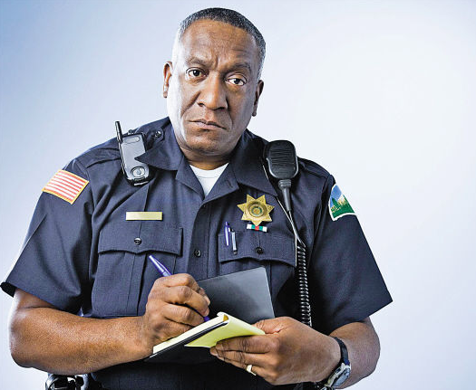
Extension Activities
Information interviews
The information interview is the most common form of interview. Whatever the topic may be, your goal during the information interview is to inform the audience.

Slide 115
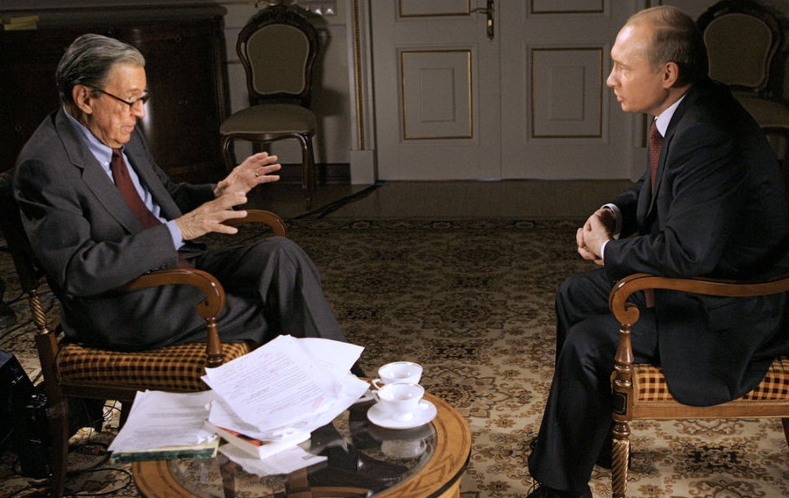
Extension Activities
Personality interviews
In this case, the person is important because of what happened to him, what he has done or the position he holds. During the personality interview, you must be versatile enough to make your delivery match the event.

Slide 116

Extension Activities
Interview methods
In most circumstances, you will use one of the following three interview methods to get the required information for your program:
Scripted Semi-scripted Ad-lib
Interview format
Simply stated, all interviews have the following three parts:
The opening The body The closing
The opening clearly identifies you, your subject and the topic.
The body is the interview itself — the actual questions and answers.
The closing is an abbreviated form of the opening.

Slide 117
Extension Activities
Interview preparation
Usually, we follow four basic interview planning steps:
Arranging the interview
Researching the subject
Formulating questions
Arranging transportation

Slide 118
Extension Activities
Helpful interview hints
Although not an all-inclusive list, the following helpful hints will make the difference between a good interview and a great interview:
Be prompt
Make your subject feel comfortable
Be attentive

Slide 119
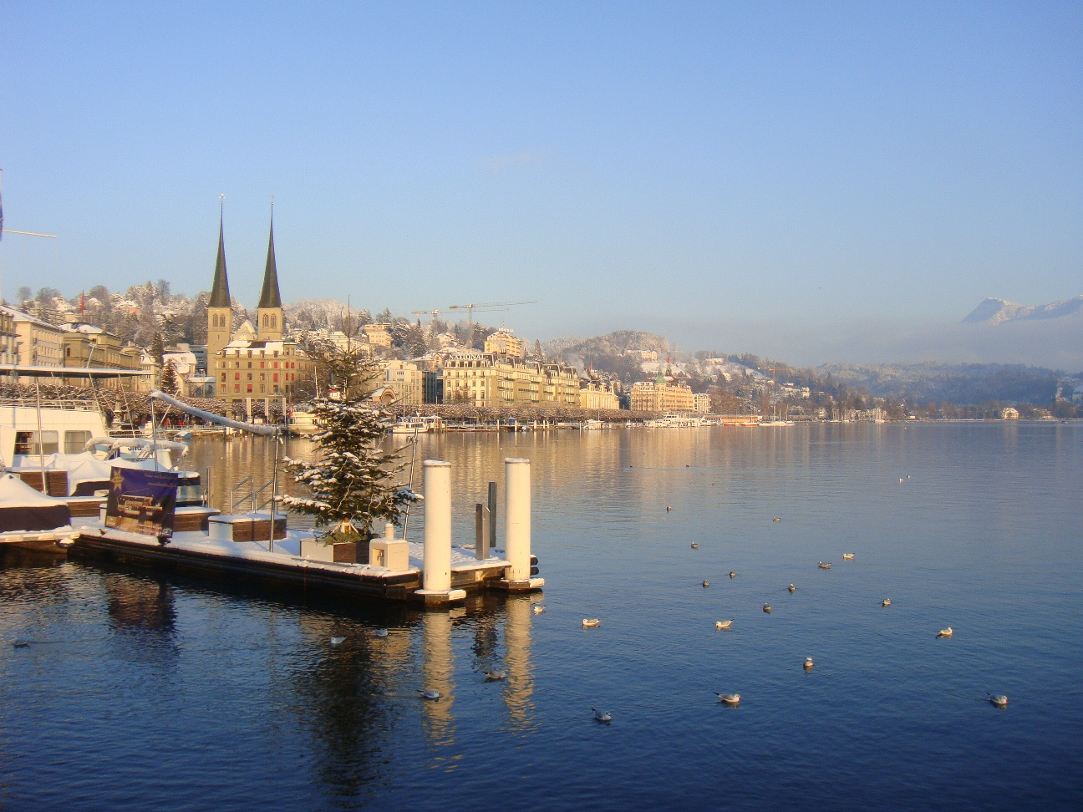
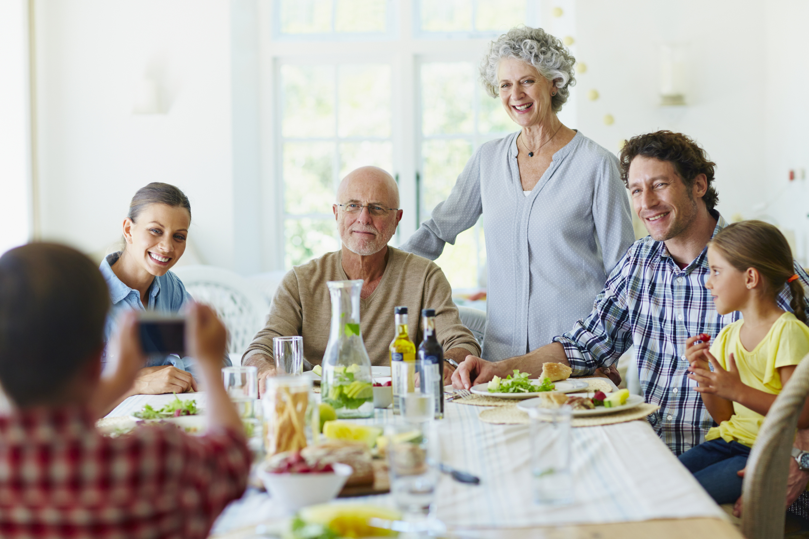
Thank you

